Slide 1
General Trees
CS 3100 – Data Structures & Algorithms
Lecture materials adapted from:
Coursenotes
A Practical Introduction to
Data Structures and Algorithm Analysis
Second Edition
Clifford A. Shaffer
Department of Computer Science
Virginia Tech
Copyright © 2000, 2001

Slide 2
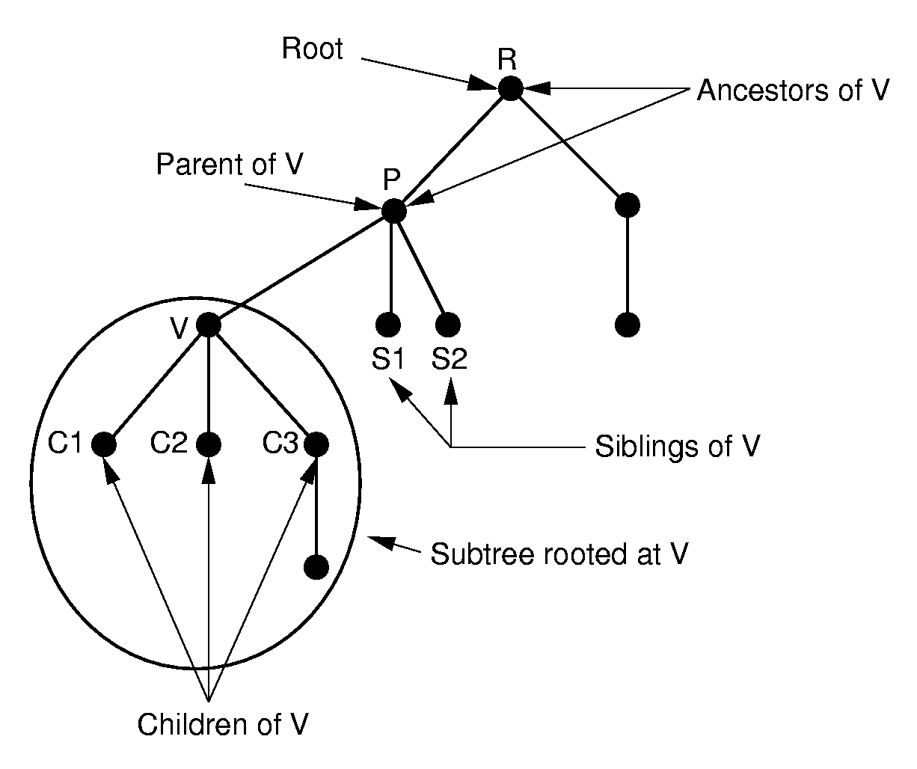
General Trees
General Trees

Slide 3
How to access children?
We could have a node contain an integer value indicating how many children it points to.
  Space for each node.
Or, we could provide a function that return the first child of a node, and a function that returns the right sibling of a node.
  No extra storage.
General Trees

Slide 4
Tree Node ADT
// General tree node ADT
template <class Elem> class GTNode {
public:
GTNode(const Elem&); // Constructor
~GTNode(); // Destructor
Elem value(); // Return value
bool isLeaf(); // TRUE if is a leaf
GTNode* parent(); // Return parent
GTNode* leftmost_child(); // First child
GTNode* right_sibling(); // Right sibling
void setValue(Elem&); // Set value
void insert_first(GTNode<Elem>* n);
void insert_next(GTNode<Elem>* n);
void remove_first(); // Remove first child
void remove_next(); // Remove sibling
};
General Trees

Slide 5
General Tree Traversal
template <class Elem>
void GenTree<Elem>::
printhelp(GTNode<Elem>* subroot) {
// Visit current node:
if (subroot->isLeaf()) cout << "Leaf: ";
else cout << "Internal: ";
cout << subroot->value() << "\n";
// Visit children:
GTNode<Elem>* temp = subroot->leftmost_child();
while (temp != nullptr) {
printhelp(temp);
temp = temp->right_sibling();
}
}
General Trees

Slide 6
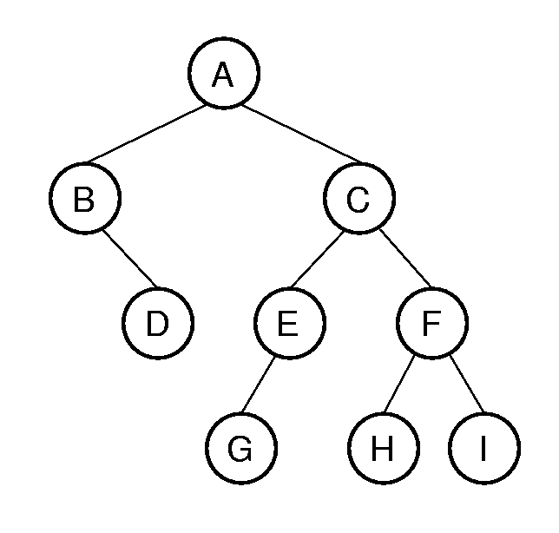
General Tree Traversal Example
printhelp(GTNode* subroot) {
// Visit current node:
cout << subroot->value() << endl;
// Visit children:
GTNode* temp = subroot->leftmost_child();
while (temp != nullptr) {
printhelp(temp);
temp = temp->right_sibling();
}
}
General Trees

Slide 7
Equivalence Class Problem
The parent pointer representation is good for answering:
  Are two elements in the same tree?
// Return TRUE if nodes in different trees
bool Gentree::differ(int a, int b) {
int root1 = FIND(a); // Find root for a
int root2 = FIND(b); // Find root for b
return root1 != root2; // Compare roots
}
General Trees
Notes:
Examples of equivalence classes:
Connected components in graphs
Point clustering

Slide 8
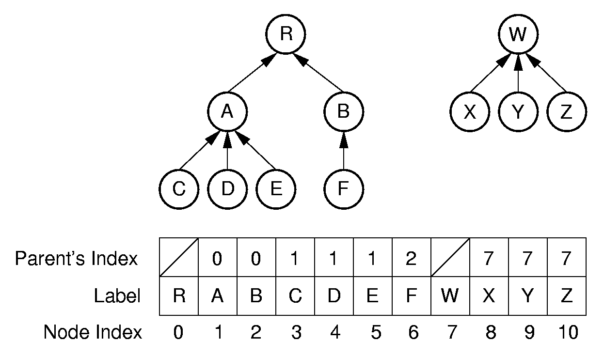
Parent Pointer Implementation
General Trees

Slide 9
Union/Find
void Gentree::UNION(int a, int b) {
int root1 = FIND(a); // Find root for a
int root2 = FIND(b); // Find root for b
if (root1 != root2) array[root2] = root1;
}
int Gentree::FIND(int curr) const {
while (array[curr]!=ROOT) curr = array[curr];
return curr; // At root
}
Want to keep the depth small.
Weighted union rule: Join the tree with fewer nodes to the tree with more nodes.
General Trees

Slide 10
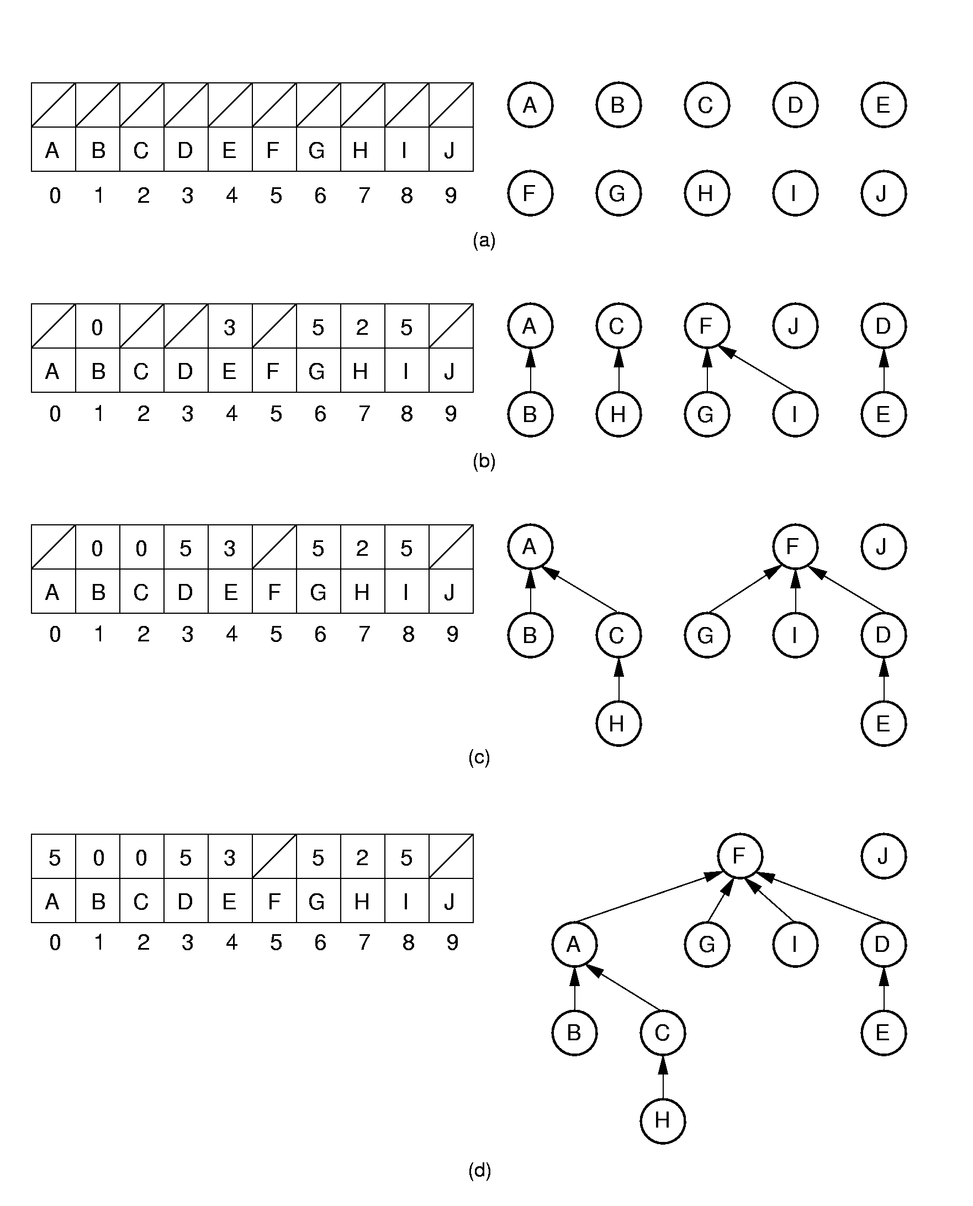
Equiv Class Processing (1)
(A, B), (C, H),
(G, F), (D, E),
and (I, F)
(H, A)
and (E, G)
General Trees
Notes:
Initially, all objects are in separate sets (equivalence classes).
(b) shows the result of processing equivalences (A, B), (C, H), (G, F), (D, E), and (I, F).
(c) shows the result of processing equivalences (H, A) and (E, G). Note that weighted union is used.

Slide 11
Equiv Class Processing (2)
(H, E)
General Trees
Notes:
(d) shows the result of processing equivalence (H, E).

Slide 12
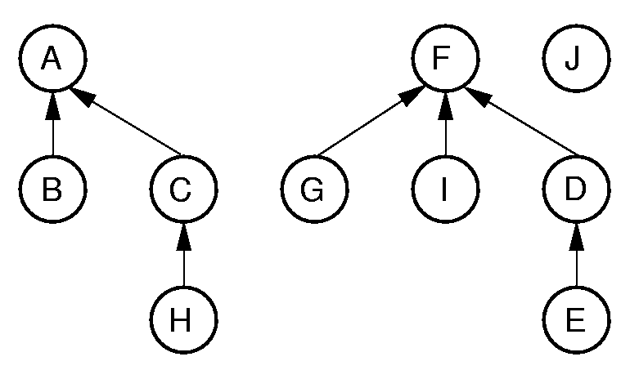
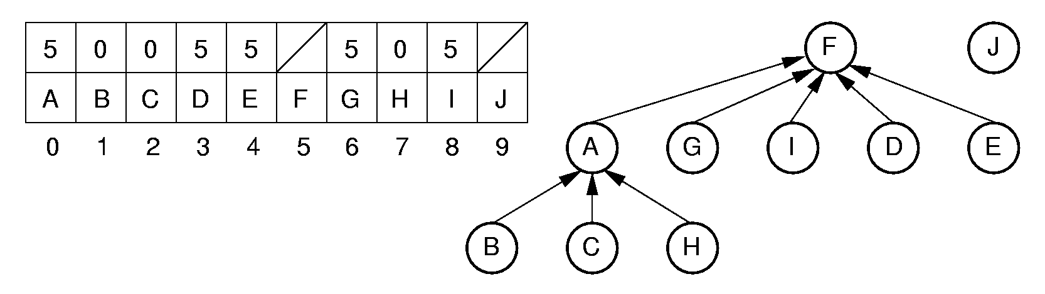
Path Compression
int Gentree::FIND(int curr) const {
if (array[curr] == ROOT) return curr;
return array[curr] = FIND(array[curr]);
}
(H, E)
General Trees
Notes:
Path compression is used to process equivalence (H, E).

Slide 13
General Tree Implementations
How efficiently can the implementation perform the operations in our ADT?
  Leftmost_child()
  Right_sibling()
  Parent()
If we had chosen other operations, the answer would be different
  Next_child() or Child(i)
General Trees

Slide 14
General Tree Strategies
Tree is in an array (fixed number of nodes)
  Linked lists of children
  Children in array (leftmost child, right sibling)
Tree is in a linked structure
  Array list of children
  Linked lists of children
General Trees

Slide 15
Lists of Children
Not very good for Right_sibling()
General Trees
Notes:
The next several slides show various possible implementations for general trees.
A key gauge for the quality of these representations is how well they perform the key tasks of left-child, right-sibling, and parent. This representation is poor for finding the right sibling of a node.

Slide 16
Leftmost Child/Right Sibling (1)
Note, two trees share the same array.
Max number of nodes may need to be fixed.
General Trees
Notes:
Note: Two trees share the same array.

Slide 17
Leftmost Child/Right Sibling (2)
Joining two trees is efficient.
General Trees
Notes:
Here, the two trees are joined together. Few links need to be adjusted in the implementation to support this join action.

Slide 18
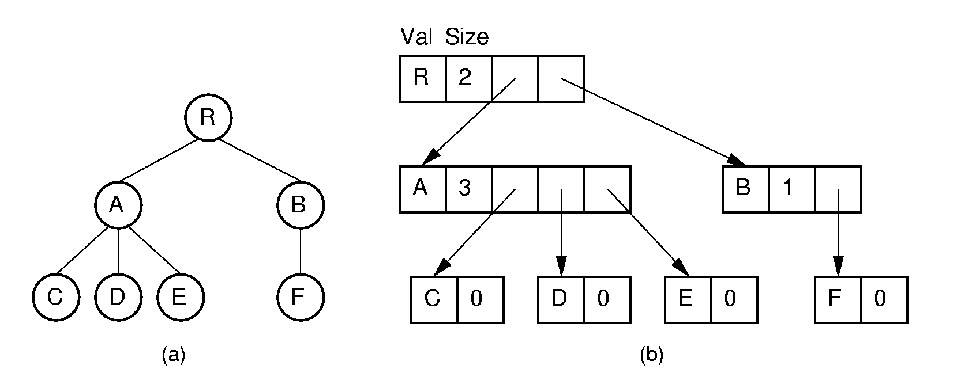
Linked Implementations (1)
An array-based list of children.
General Trees
Notes:
Essentially an array-based list of children.

Slide 19
Linked Implementations (2)
A linked-list of children.
General Trees
Notes:
Essentially a linked list of children.

Slide 20
A
B
C
General Trees

Slide 21
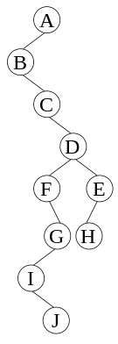
General Tree Implementations
Tree Nodes
Array elements
Nodes & Pointers
Leftmost-child/Right sibling
array
Arrays (or vectors) of children
Array elements
Tree Structure
Lists-of-children array
Fully-linked OR binary-tree
Nodes & Pointers
General Trees

Slide 22
Sequential Implementations (1)
List node values in the order they would be visited by a preorder traversal.
Saves space, but allows only sequential access.
Need to retain tree structure for reconstruction.
Example: For binary trees, use a symbol to mark null links.
AB/D//CEG///FH//I//
General Trees
Notes:
This example refers to the tree of Figure 6.16.

Slide 23
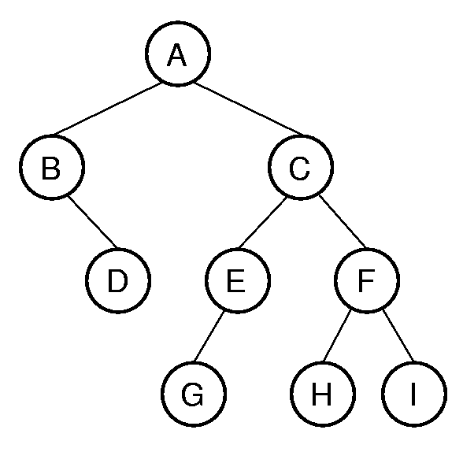
Binary Tree Sequential Implementation
AB/D//CEG///FH//I//
reconstruct(int& i) {
if (array[i] == ‘/’){
i++;
return NULL;
}
else {
newnode = new node(array[i++]);
left = reconstruct(i);
right = reconstruct(i);
return(newnode)
}
}
int i = 0;
root = reconstruct(i);
General Trees

Slide 24
Sequential Implementations (2)
Example: For full binary trees, mark nodes as leaf or internal.
A’B’/DC’E’G/F’HI
Space savings over previous method by removing double ‘/’ marks.
General Trees
Notes:
The first example includes two “/” marks because the example tree is not full. Cost is one additional bit per node.
The second example refers to the general tree of Figure 6.3.

Slide 25
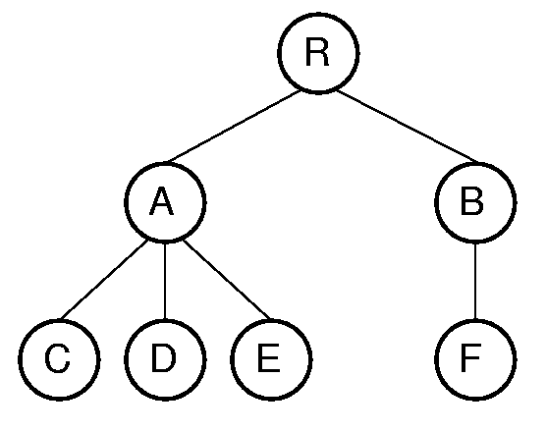
Sequential Implementations (2)
Example: For general trees, mark the end of each subtree.
RAC)D)E))BF)))
General Trees
Notes:
The first example includes two “/” marks because the example tree is not full. Cost is one additional bit per node.
The second example refers to the general tree of Figure 6.3.

Slide 26
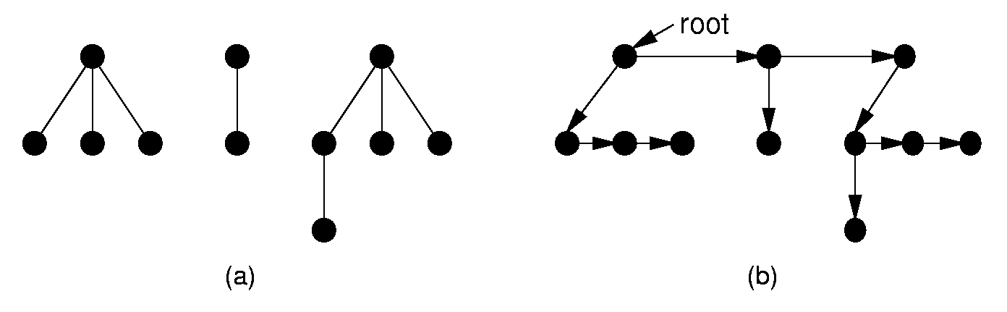
Converting to a Binary Tree
Left child/right sibling representation essentially stores a binary tree.
Use this process to convert any general tree to a binary tree.
A forest is a collection of one or more general trees.
General Trees
Notes:
The result is essentially a dynamic implementation for the left child/right sibling representation for general trees.

Slide 27
Converting to a Binary Tree
Binary tree left child
= leftmost child
Binary tree right child
= right sibling
A
B
C
D
A
F
E
B
C
D
E
G
H
F
G
H
I
J
I
J
General Trees

